Slide 1
FEATURE DETECTION AND MATCHING

Slide 2
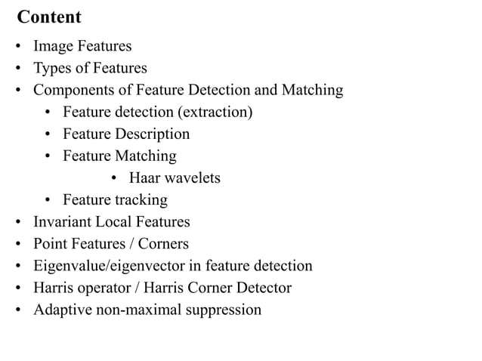

Slide 3
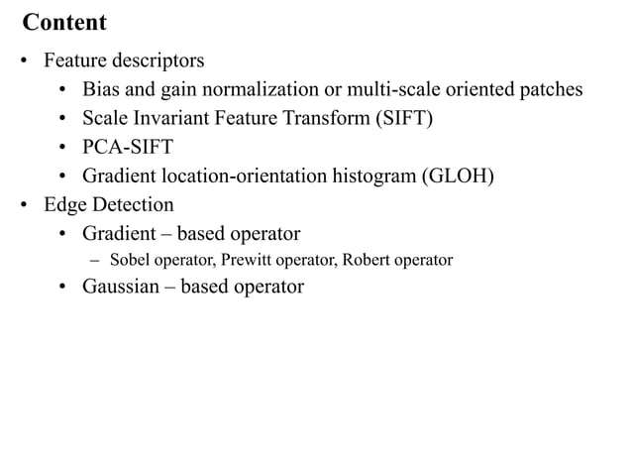

Slide 4
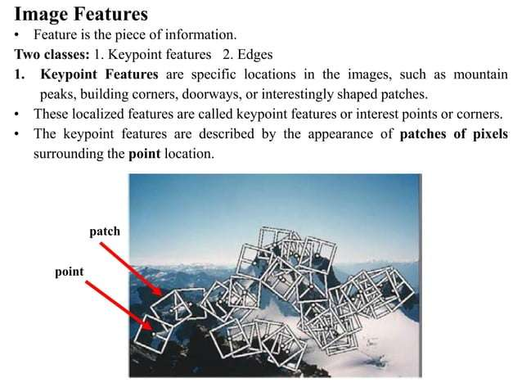

Slide 5
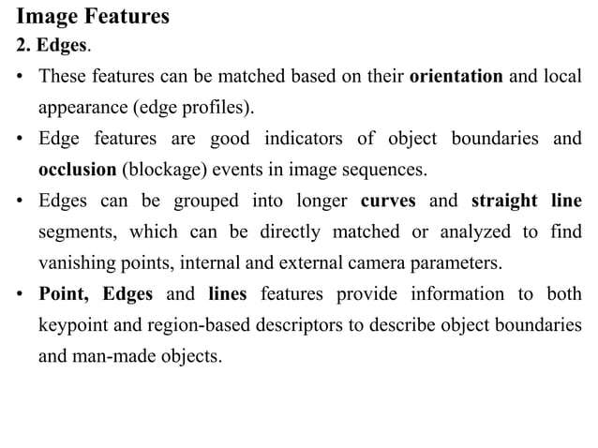

Slide 6
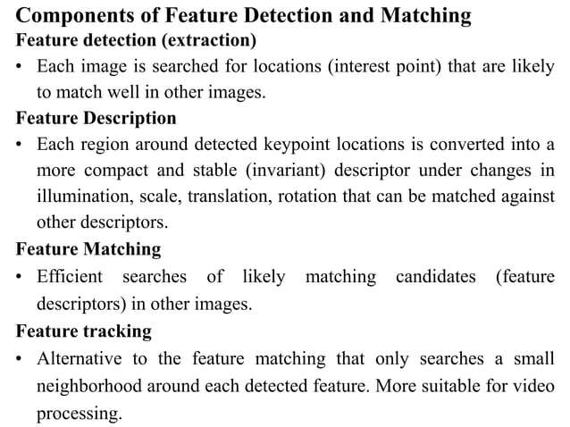

Slide 7
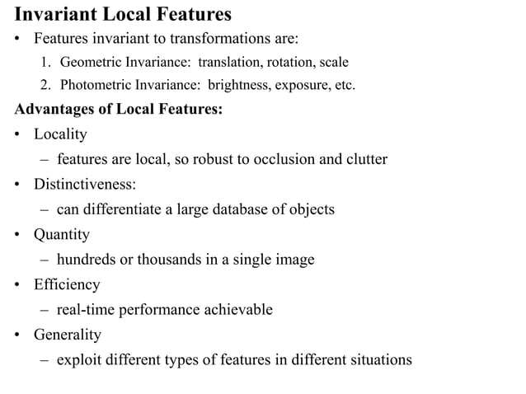

Slide 8
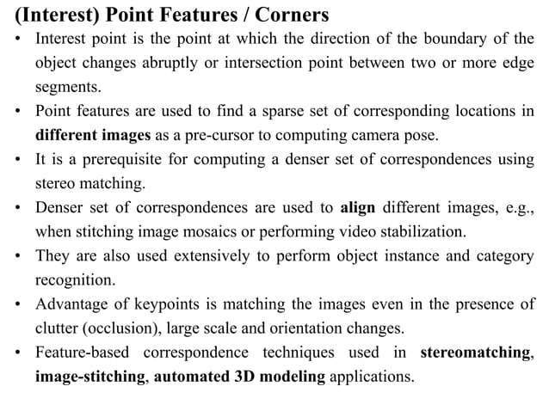

Slide 9
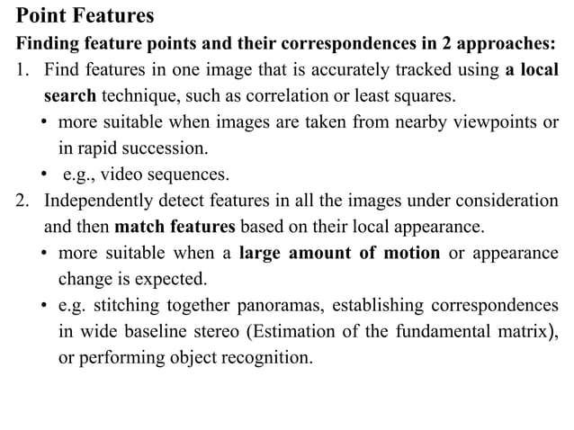

Slide 10
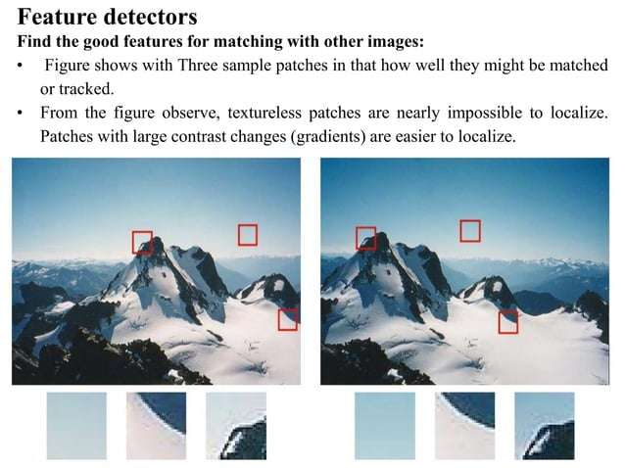

Slide 11
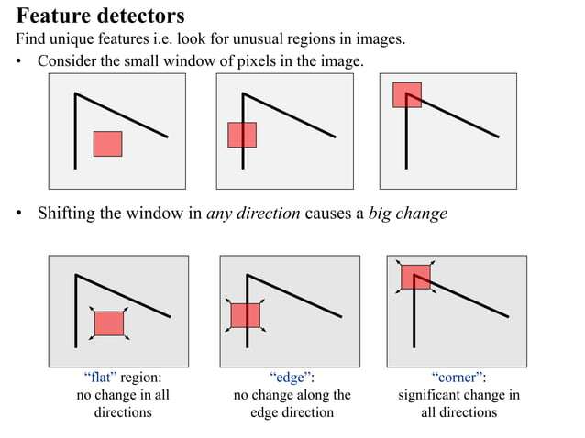

Slide 12
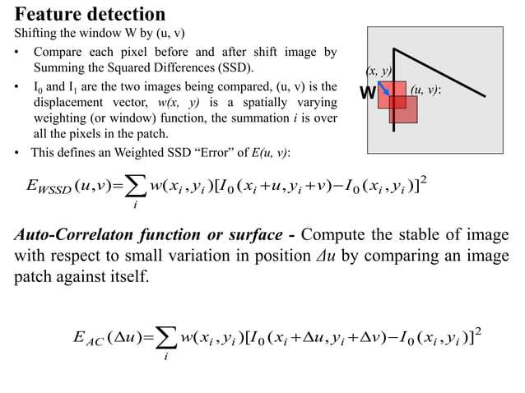

Slide 13
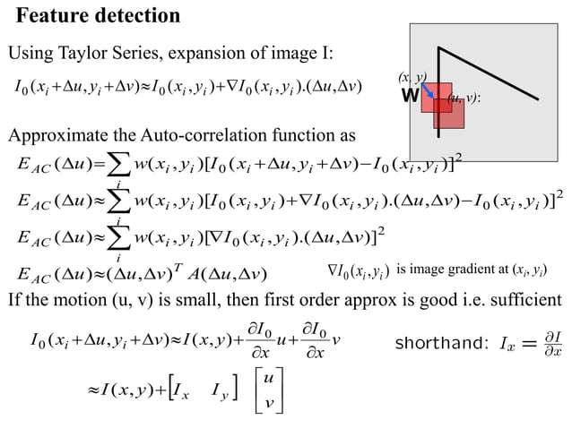

Slide 14
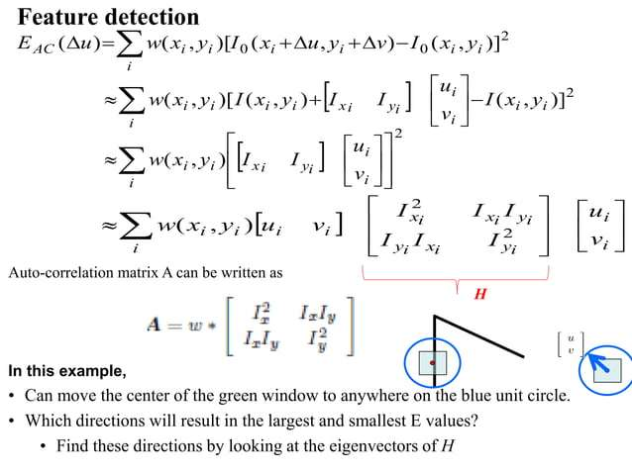

Slide 15
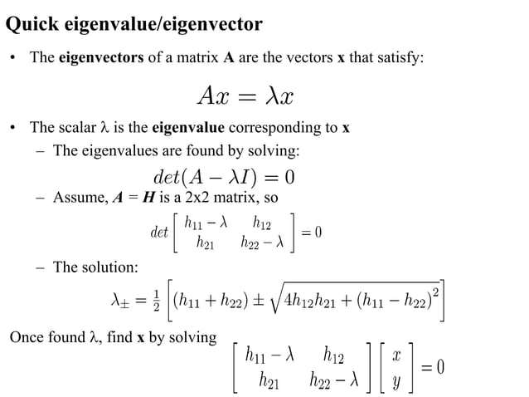

Slide 16
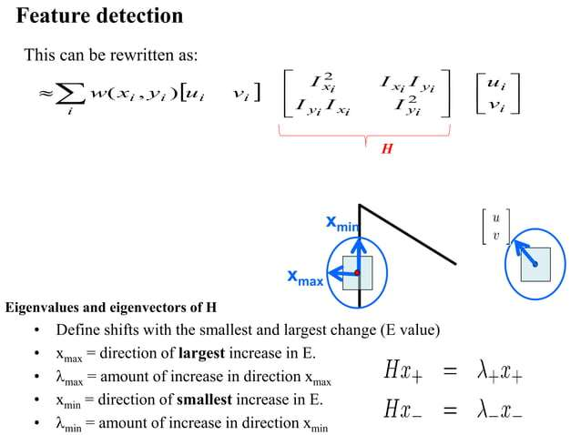

Slide 17
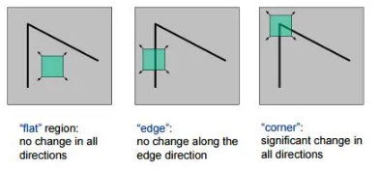
HARRIS CORNER DETECTOR
Corner
A corner is a point whose local neighborhood stands in two dominant and different edge directions. In other words, a corner can be interpreted as the junction of two edges, where an edge is a sudden change in image brightness. Corners are the important features in the image, and they are generally termed as interest points which are invariant to translation, rotation, and illumination.

Slide 18
HARRIS CORNER DETECTOR
If we take the flat region then no gradient change is observed in any direction.
Similarly, in the edge region, no gradient change is observed along the edge direction. So both flat region and edge region are bad for patch matching since they not very distinctive (there are many similar patches in along edge in edge region).
While in corner region we observe a significant gradient change in all direction. Due this corners are considered good for patch matching(shifting the window in any direction yield a large change in appearance) and generally more stable over the change of viewpoint.

Slide 19
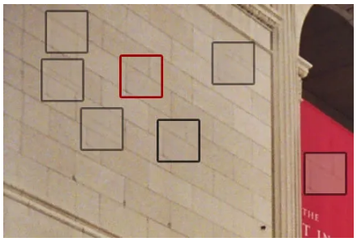
HARRIS CORNER DETECTOR
Corner Detection
The idea is to consider a small window around each pixel p in an image. We want to identify all such pixel windows that are unique. Uniqueness can be measured by shifting each window by a small amount in a given direction and measuring the amount of change that occurs in the pixel values.

Slide 20
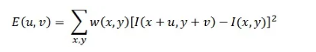
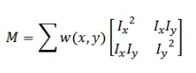
HARRIS CORNER DETECTOR
We take the sum squared difference (SSD) of the pixel values before and after the shift and identifying pixel windows where the SSD is large for shifts in all 8 directions.
The features in the image are all pixels that have large values of E(u,v), as defined by some threshold.
We have to maximize this function E(u,v) for corner detection.
Applying Taylor Expansion to the above equation and using some mathematical steps, we get the final equation as:

Slide 21
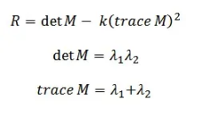
HARRIS CORNER DETECTOR
By solving for the eigenvectors of M, we can obtain the directions for both the largest and smallest increases in SSD. The corresponding eigenvalues give us the actual value amount of these increases. A score, R, is calculated for each window:
λ1 and λ2 are the eigen values of M. So the values of these eigen values decide whether a region is a corner, edge or flat.

Slide 22
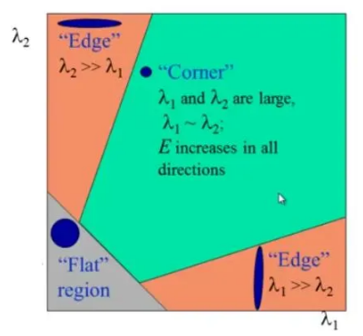
HARRIS CORNER DETECTOR
When |R| is small, which happens when λ1 and λ2 are small, the region is flat.
When R<0, which happens when λ1>>λ2 or vice versa, the region is an edge.
When R is large, which happens when λ1 and λ2 are large and λ1∼λ2, the region is a corner.

Slide 23
HARRIS CORNER DETECTOR
1.Take the grayscale of the original image
2. Apply a Gaussian filter to smooth out any noise
3. Apply Sobel operator to find the x and y gradient values for every pixel in the grayscale image
4. For each pixel p in the grayscale image, consider a 3×3 window around it and compute the corner strength function. Call this its Harris value.
5. Find all pixels that exceed a certain threshold and are the local maxima within a certain window (to prevent redundant dupes of features)
6. For each pixel that meets the criteria in 5, compute a feature descriptor.

Slide 24
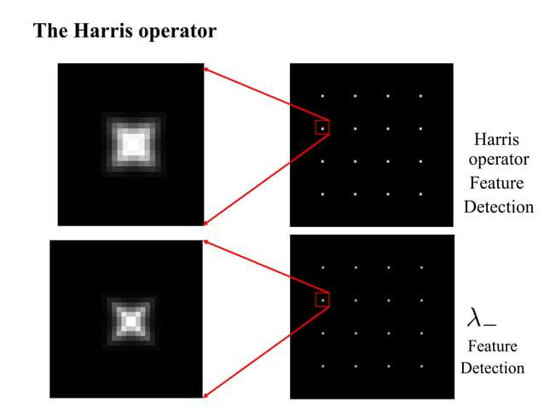

Slide 25
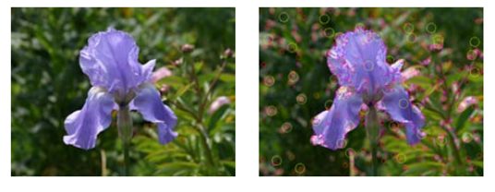
HARRIS DETECTOR EXAMPLE
Original Image Harris response

Slide 26
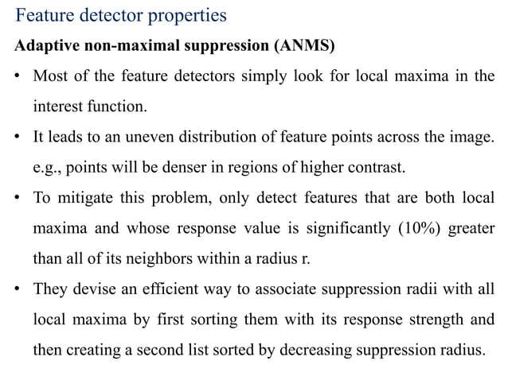

Slide 27
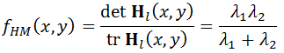
Adaptive Non Maximal Suppression
1. Feature extraction:
Identify potential features in the image using a feature detector, which usually assigns a confidence score to each detected feature.
Eg: corner strength function:
which is the harmonic mean of the Eigen values of H.
2. Adaptive suppression radius calculation:
For each feature, find the nearest neighbor with a higher confidence score and calculate the distance between them. This distance becomes the suppression radius for that feature.
3. Non-maximal suppression:
Compare each feature to its neighbors within its calculated suppression radius; if a neighbor has a higher confidence score, the current feature is suppressed.

Slide 28
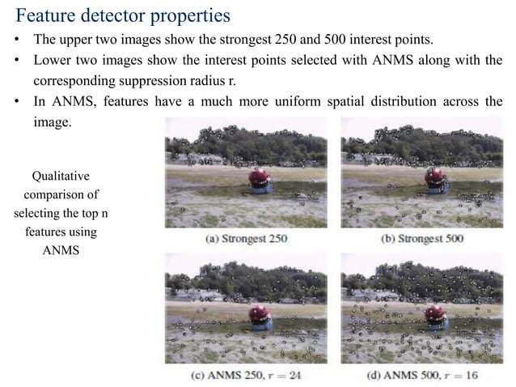

Slide 29
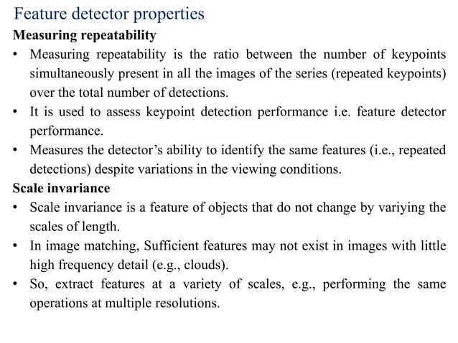

Slide 30
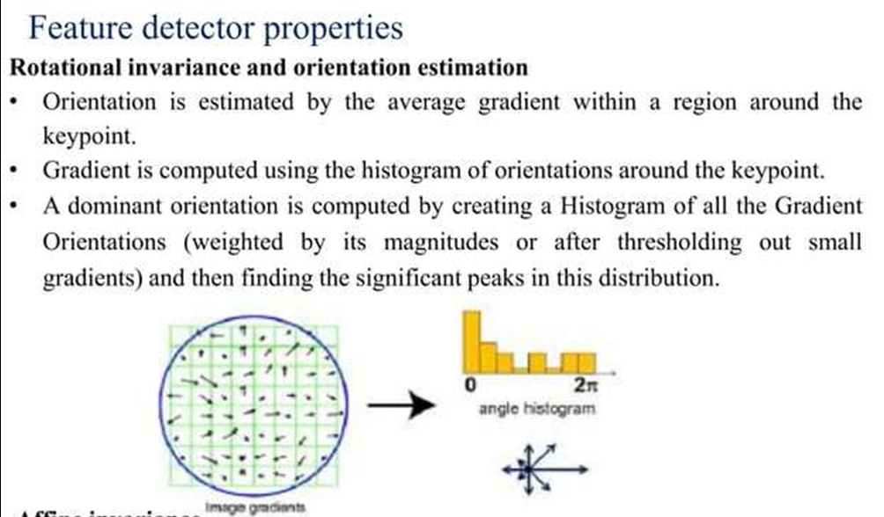

Slide 31
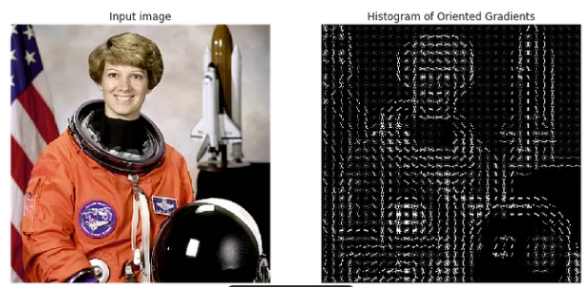
Histogram of Oriented Gradients(HOG)
The Histogram of Oriented Gradients (HOG) is a feature descriptor used in computer vision and image processing to detect objects or recognize patterns. It works by capturing the structure and texture of an image, specifically focusing on the gradients, which represent changes in intensity.

Slide 32
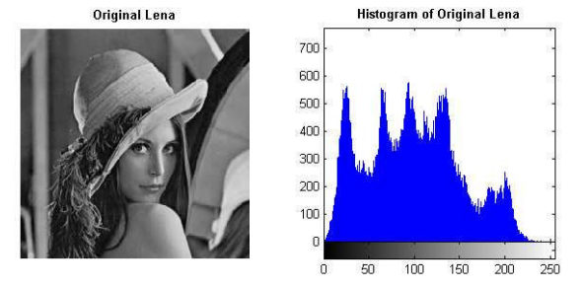
Histogram of Oriented Gradients(HOG)
Histogram-A graphical representation of the frequency distribution of data- in this case, the gradients’ directions.
Oriented: Refers to the direction of the gradients.
Gradients: Represent changes in pixel intensity values, capturing the edges, textures, and structures in the image.

Slide 33
Histogram of Oriented Gradients(HOG)
In Histogram of Oriented Gradients (HOG), the gradients are not calculated at every direction from 0° to 180° for each pixel. Instead, the gradients are calculated in specific directions and then binned into orientation bins, typically spanning from 0° to 180°.
Gradients are calculated once per pixel (based on Gx​ and Gy​).
Gradient directions (θ) are quantized into specific bins (e.g., 9 or 18 bins).

Slide 34
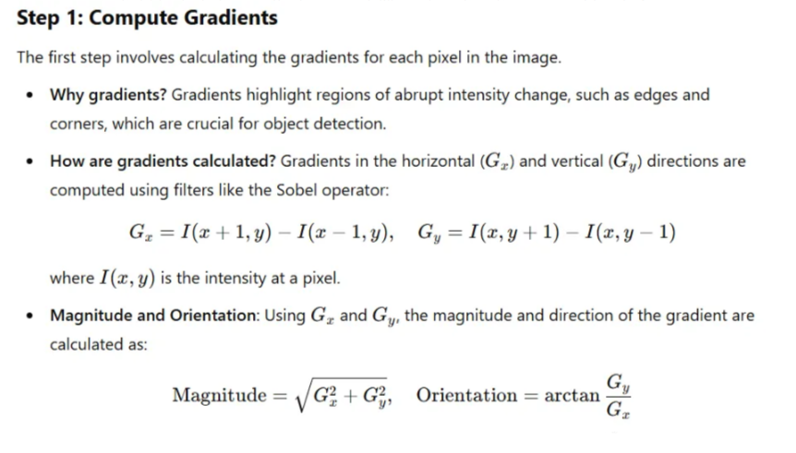
Histogram of Oriented Gradients(HOG)

Slide 35
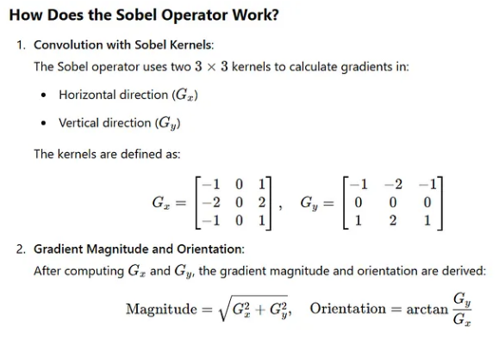
Histogram of Oriented Gradients(HOG)

Slide 36
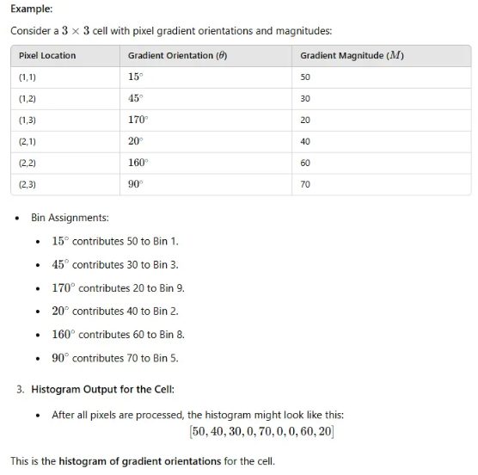
Histogram of Oriented Gradients(HOG)
Step 2: Divide the Image into Cells
The image is divided into small non overlapping rectangular or square regions called cells (e.g., 8×8 pixels per cell).
Each cell independently computes a histogram of gradient orientations.
Orientations are quantized into bins (e.g., 9 bins representing angles from 0° to 180°).

Slide 37
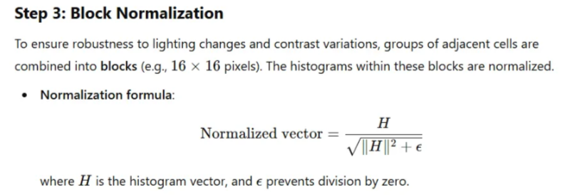
Histogram of Oriented Gradients(HOG)

Slide 38
A histogram of oriented gradients (HOG) is a technique used in computer vision and image processing to identify objects and patterns. It's a feature descriptor that analyzes the shape of an object by counting the orientation of gradients in local areas of an image.
How it works
Break an image into a grid of cells
Calculate a histogram of gradients for each cell
Normalize the histogram by taking into account the overlapping contrast of local cells
Use the magnitude and orientation of the gradient to generate a histogram
Applications
Object detection
Pedestrian detection
Image classification
Quantifying the spatial correlation between two images
Medical imaging tasks like detection, segmentation, and classification
HOG's advantages
It's robust at capturing edge, shape, and texture information
It's invariant to geometric transformations and lighting variations
Related terms
Gradients: Represent changes in pixel intensity values
Feature descriptors: Represent an image by extracting useful information and ignoring unnecessary information

Slide 39
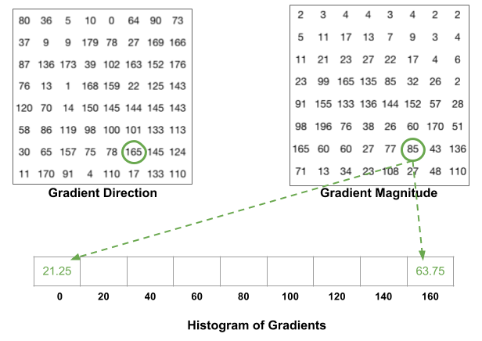
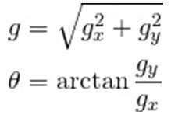
Histogram of Gradients

Slide 40
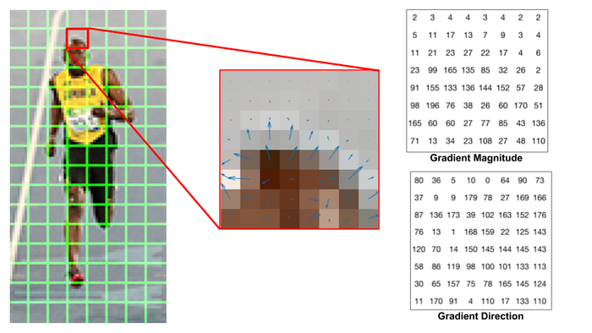
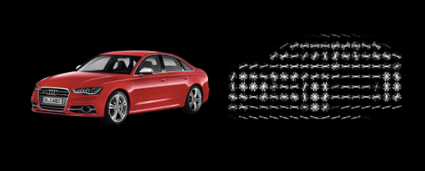

Slide 41
Feature Detector Properties
Affine Invariance
In computer vision, "affine invariance" refers to the property of an algorithm or feature descriptor that remains unchanged even when an image is subjected to an affine transformation, such as scaling, shearing, or rotation, allowing it to identify objects regardless of their orientation and perspective in the image plane; essentially, it means the algorithm can recognize the same object even if it appears stretched, skewed, or tilted in the image.
Applications:
Affine invariant features are particularly useful in applications like object tracking, image registration, and visual recognition where objects might undergo different affine transformations due to camera viewpoint changes or object pose variations.

Slide 42
Feature Detector Properties
Achieving affine invariance:
To achieve affine invariance, algorithms typically analyze local image features using techniques like calculating the local image gradient and fitting an ellipse to capture the shape information, which is less sensitive to affine deformations.
Examples of affine invariant feature detectors:
Scale Invariant Feature Transform (SIFT):
While not fully affine invariant, SIFT is a widely used feature descriptor that is robust to scale changes and partially resistant to affine deformations.
Maximally Stable Extremal Regions (MSER):
This method is known for its strong affine invariance as it identifies regions in an image that are stable under affine transformations.

Slide 43
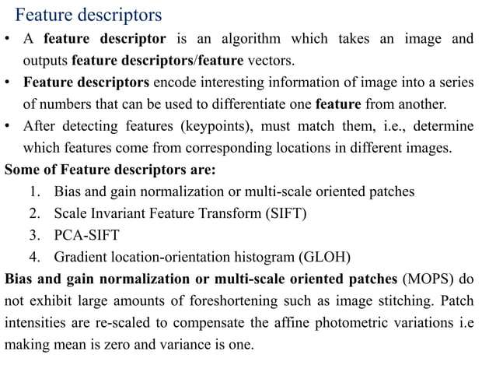

Slide 44
Feature descriptor SIFT(Scale Invariant Feature Transform)
There are mainly four steps involved in the SIFT algorithm.
Scale-space peak selection: Potential location for finding features.
Key point Localization: Accurately locating the feature key points.
Orientation Assignment: Assigning orientation to key points.
Key point descriptor: Describing the key points as a high dimensional vector.

Slide 45
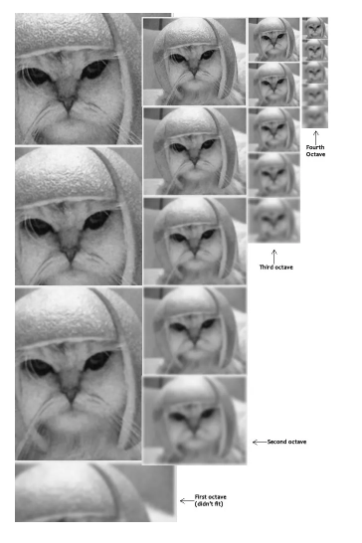
Feature descriptor SIFT(Scale Invariant Feature Transform)
Scale-space peak Selection:
Real world objects are meaningful only at a certain scale.The scale space of an image is a function L(x,y,σ) that is produced from the convolution of a Gaussian kernel(Blurring) at different scales with the input image. Scale-space is separated into octaves and the number of octaves and scale depends on the size of the original image. Each octave’s image size is half the previous one.

Slide 46
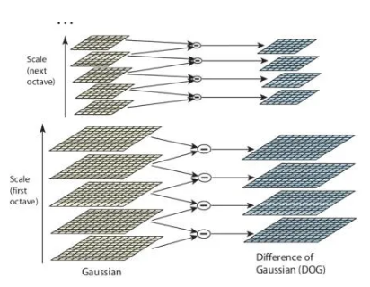
Feature descriptor SIFT(Scale Invariant Feature Transform)
Within an octave, images are progressively blurred using the Gaussian Blur operator.
Now we use those blurred images to generate another set of images, the Difference of Gaussians (DoG). These DoG images are great for finding out interesting keypoints in the image.
This process is done for different octaves of the image in the Gaussian Pyramid.

Slide 47
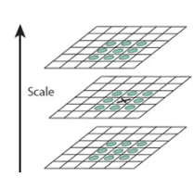
Feature descriptor SIFT(Scale Invariant Feature Transform)
Up till now, we have generated a scale space and used the scale space to calculate the Difference of Gaussians. Those are then used to calculate Laplacian of Gaussian approximations that are scale invariant.
One pixel in an image is compared with its 8 neighbors as well as 9 pixels in the next scale and 9 pixels in previous scales. This way, a total of 26 checks are made. If it is a local extrema, it is a potential keypoint. It basically means that keypoint is best represented in that scale.

Slide 48
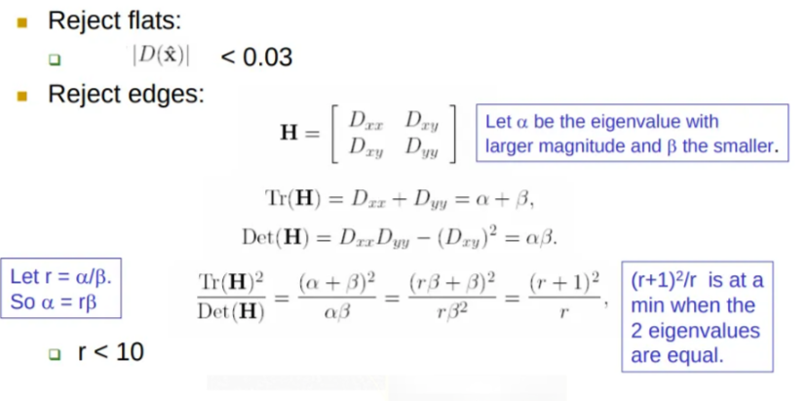
Feature descriptor SIFT(Scale Invariant Feature Transform)
Keypoint Localization
Key points generated in the previous step produce a lot of key points. Some of them lie along an edge, or they don’t have enough contrast. In both cases, they are not as useful as features.
Taylor series expansion of scale space is applied to get more accurate location of extrema, and if the intensity at this extrema is less than a threshold value (0.03 as per the paper), it is rejected. DoG has a higher response for edges, so edges also need to be removed. They used a 2x2 Hessian matrix (H) to compute the principal curvature.

Slide 49
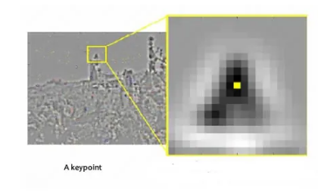
Feature descriptor SIFT(Scale Invariant Feature Transform)
Orientation Assignment
Now we have legitimate key points. They’ve been tested to be stable. We already know the scale at which the key point was detected (it’s the same as the scale of the blurred image). So we have scale invariance. The next thing is to assign an orientation to each keypoint to make it rotation invariance.

Slide 50
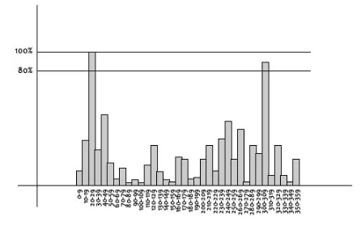
Feature descriptor SIFT(Scale Invariant Feature Transform)
A neighborhood is taken around the key point location depending on the scale, and the gradient magnitude and direction is calculated in that region. An orientation histogram with 36 bins covering 360 degrees is created.
Once this for all pixels around the key point, the histogram will have a peak at some point.
The highest peak in the histogram is taken and any peak above 80% of it is also considered to calculate the orientation. It creates key points with same location and scale, but different directions.

Slide 51
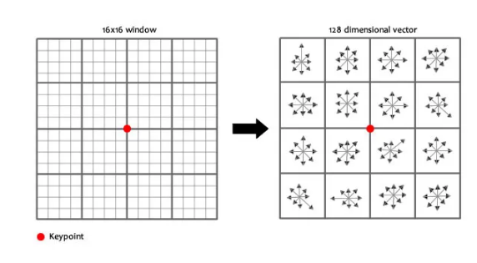
Feature descriptor SIFT(Scale Invariant Feature Transform)
Key point descriptor
At this point, each key point has a location, scale, orientation. Next is to compute a descriptor for the local image region about each key point that is highly distinctive and invariant as possible to variations such as changes in viewpoint and illumination.
To do this, a 16x16 window around the key point is taken. It is divided into 16 sub-blocks of 4x4 size.

Slide 52
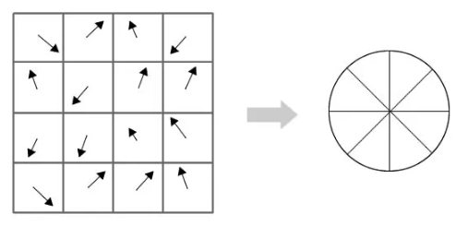
Feature descriptor SIFT(Scale Invariant Feature Transform)
For each sub-block, 8 bin orientation histogram is created.
4 X 4 X 8 directions give 128 bin values. It is represented as a feature vector to form keypoint descriptor.

Slide 53
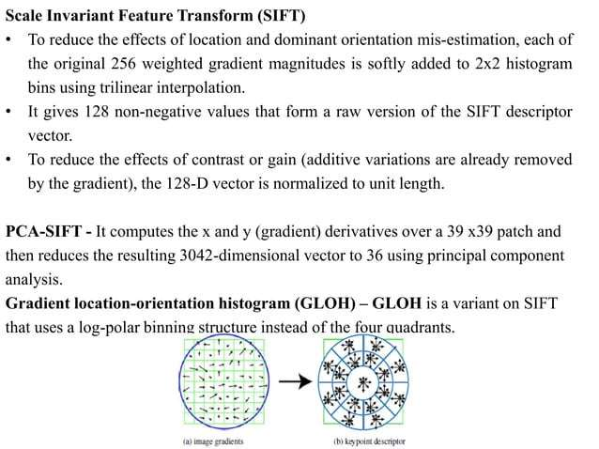

Slide 54
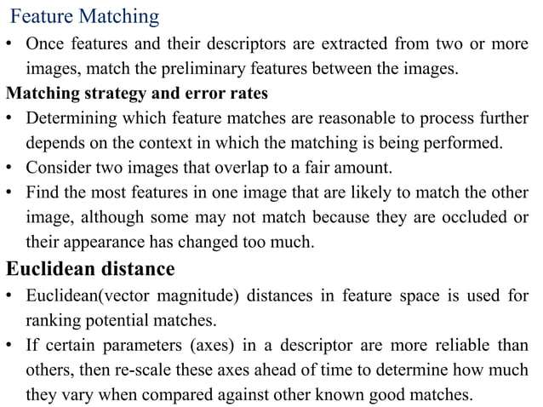

Slide 55
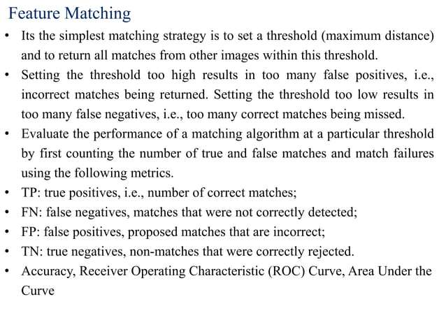

Slide 56


Slide 57


Slide 58


Slide 59



Slide 60


Slide 61


Slide 62


Slide 63


Slide 64


Slide 65

Edge Detection-Guassian based Operator
Canny Edge Detector

Slide 66


Slide 67


Slide 68
THANK YOU

